Slide 1
Statistical Pred Modelling Assignment 2
Submitted by:
Vrushali Gajjar
[100891561]

Slide 2
Rational Statement
Here, we have some independent and one dependent variable in our dataset. Where Kecimen and Besni raisin are dependent variable as ‘Class’.
Where with the help of logistic regression model, it will present some of the findings as under:
Slides will present Learning Curve with the explanation of Biased and variance. Also, We will see confusion matrix for model optimizing.
Besides this, future slides will present ROC and NUC curve.
In the end, it will show some of the recommendation for this model.

Slide 3
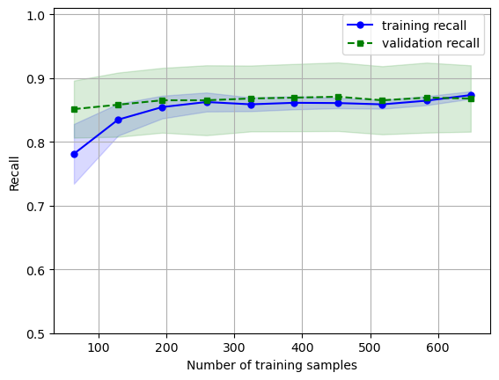
Learning Curve
The leaning curve shows recall for validation and training set as per the number of training samples.
Here, we can clearly identify that training curve is starting from 0.78 to increase significantly at 0.85. where validation curve is starting with 0.84 that continue around 0.86 in the end.
Where we can identify the model as a low biased.

Slide 4
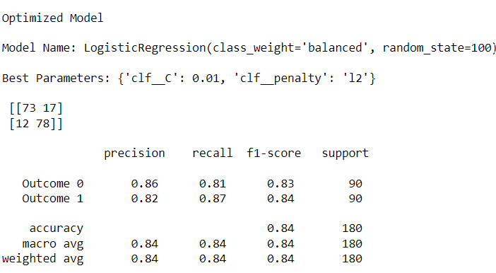
Confusion Matrix/Classification Report
[[73 17] [12 78]]
[[73 17] [12 78]]
As a optimised model for logistic regression the confusion matrix shows results as under:
[[73 17]
[12 78]]
Our outcome 0 precision is 0.86, recall is 0.81 F1 is 0.83. So that we can say that it is a good model for us to identify any problems.
Also, for outcome 1 precision is 0.82, recall is 0.87 and F1 is 0.84 with is again good outcomes for the models.
It can be seen that, accuracy for this model is 0.84 to be more confident for this model.

Slide 5
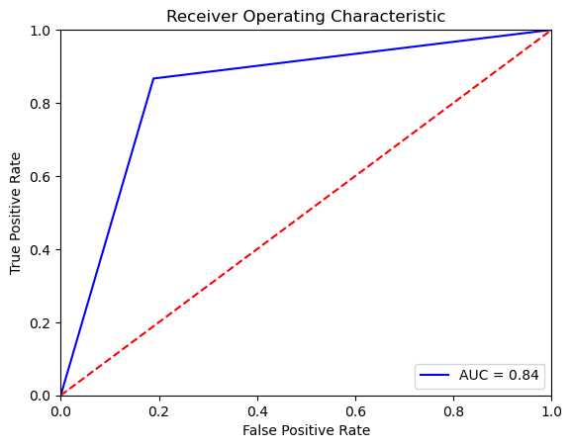
ROC/AUC Curve
The blue colored AUC curve says that model is around 82%.
The curve shows that is can predict true positive and false positive for 84% of the time for this model.

Slide 6
Recommendation
This model is a good model for start. However, we can recommend to Mr. John that
We can use feature scaling for this model to get more accurate results.
We can do feature engineering to get more accurate model performance.
Also, After separating the data into training and testing sets, we must train the model using the training set. Use cross-validation techniques to assess the model's performance on the testing set.

